Slide 1
Operating System
Liu Cui

Slide 2
Road map
Overview of Operating Systems and the components
Operating Systems Core
Processes (Kernel, pre-emptive multitasking)
Virtual Memory
File
Threads
Linux

Slide 3
A java program
public class HelloWorld
{
public static void main(String[] args)
{
System.out.println(“Hello World!”);
}
}

Slide 4
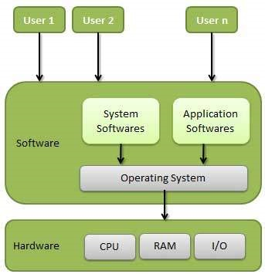
The Operating System
When the shell loaded and ran the HelloWorld program, and when the HelloWorld program prints its message, neither program accessed the keyboard, display, disk, or main memory directly.
Rather, they relied on the services provided by the operating system.
We can think of the operating system as a layer of software interposed between the application program and the hardware.

Slide 5
The Operating System
An operating system is software that manages all of the hardware resources associated with your electronic devices.
It manages the communication between your software and hardware.
Without the operating system (OS), the software wouldn’t function.
Examples: Just link Windows 8 and Mac OS X, Linux

Slide 6
The Operating System Components
The Operating System is comprised of a number of pieces:
The Bootloader: The software that manages the boot process of your computer. For most users, this will simply be a splash screen that pops up and eventually goes away to boot into the operating system.
The kernel: This is the one piece of the whole that is actually called “Linux”, “Windows”, or “Mac OS”. The kernel is the core of the system and manages the CPU, memory, and peripheral devices. The kernel is the “lowest” level of the OS.

Slide 7
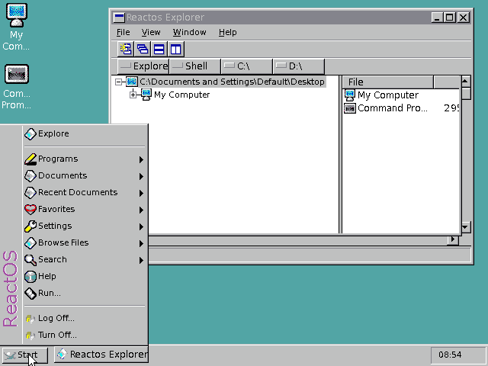
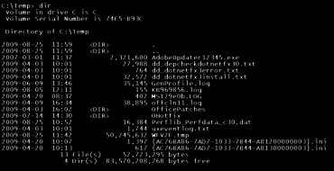
The Operating System Components
Daemons: These are background services (printing, sound, scheduling, etc) that either start up during boot, or after you log into the desktop.
The Shell: is a user interface that allows you to control the computer. OS shells use either command-line interface (CLI) or graphical user interface (GUI). It is named a shell because it is a layer around the OS kernel.

Slide 8
The Operating System Components
Graphical Server: This is the sub-system that displays the graphics on your monitor.
Desktop Environment: This is the piece of the puzzle that the users actually interact with. Each desktop environment includes built-in applications (such as file managers, configuration tools, web browsers, games, etc)

Slide 9
The Operating System
The operating system has two primary purposes:
To protect the hardware from misuse by runaway applications and
To provide applications with simple and uniform mechanisms for manipulating complicated and often widely different low-level hardware devices.
The operating system achieves both goals via the fundamental abstractions
Processes
Virtual memory
files

Slide 10
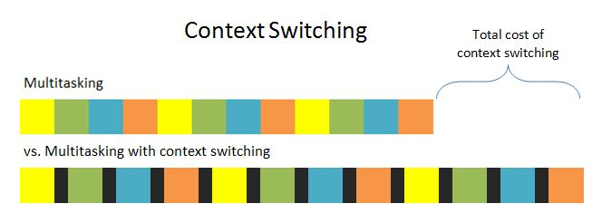
Process
A process is the operating system’s abstraction for a running program.
Multiple processes can run concurrently on the same system, and each process appears to have exclusive use of the hardware.
By concurrently, we mean that the instructions of one process are interleaved with the instructions of another process.
Notes:
When a program such as HelloWorld runs on a modern system, the operating system provides the illusion that the program is the only one running on the system. The program appears to have exclusive use of both the processor, main memory, and program appears to have exclusive use of both the processor, main memory, and I/O devices. The processor appears to execute the instructions in the program, one after the other, without interruption. And the code and data of the program appear to be the only objects in the system’s memory. These illusions are provided by the notion of a process, one of the most important and successful ideas in computer science.
A primary purpose of modern operating system is to allow multiple processes to run concurrently, meaning at the same time. The problem is of course one CPU core can only run the code of one process at a time, and the OS’s own code can run on the core at the same time as any process. The solution is to have each CPU core alternate between running each open process and alternate running processes with running OS’s code.

Slide 11
Kernel
The transition from one process to another is managed by the operating system Kernel.
The kernel is the portion of the operating system code that is always resident in memory.
When an application program requires some action by the operating system, such as to read or write a file, it requires some action by the operating system, such as to read or write a file, it executes a special system call instruction, transferring control to the kernel.
The kernel then performs the requested operation and returns back to the application program.
Note that the kernel is not a separate process. Instead, it is a collection of code and data structures that the system uses to manage all the processes.

Slide 12
Pre-emptive Multitasking
CPU receives interrupt
Interrupt stores in program counter
Interrupt invokes handler
Handler saves rest of process state
Handler does its business
Handler invokes the scheduler
Scheduler selects a process to run
Scheduler restores state for that process
Scheduler jumps execution to that process
Notes:
The question is then how the current running process get interrupted.
Left on its own, a running process will continue forever. When any hardware interrupt triggered, however, the interrupt handler passes its control to the scheduler rather than hand it in the processor core. The scheduler then decide what OS code to run if any and what process should run next.

Slide 13
Questions
Q1: What if no interrupt distributed by any device for a long time?
A: that will allow the current running program to use all the CPU time. Generally, we want each process to at least get a little time on a regular basis (several times per second). A video game, for example, cannot go without CPU time for more than a fraction of a second. So, it will be no good if some other processes run without interruption for a second or more. To ensure the scheduler to run on a regular basis, whether any I/O device need attention or not, a clock device on the main board is configured to send interruption every 10-20 ms. Thus, the system guarantees the system will get the opportunity to change the running process on each core at least several times a second.

Slide 14
Questions
Q2: How does the scheduler choose what process to go next
A: Use simple algorithm, such as Round Robin, processes will run on each core in turn. This guarantees each process can run on a regular basis. Modern OS also takes into account what process need more CPU time than others, etc.

Slide 15
Process
After the OS does all its business the time needs for process creation, the process transit to the waiting state (waiting to be selected by the scheduler).
When the scheduler selects the process to run, it enters the running state.
When the scheduler selects a different process to run on the same core, this process is back to the waiting state.
When a process waits for external events for the system before proceed (reading files), it is in the blocked state.
Once the OS finishing retrieving requested data from storage, it unblock the process, put it back in the waiting state, so the scheduler will consider it again for execution.
Created
Terminated
Waiting
Running
Blocked
Notes:
A process typically goes back and forth many time between waiting and running, until the process ends at which point enters the final state terminated.
Reading files often block the process, since most storage devices such as hard drive are relatively much slower than the OS, and the process need to wait the data getting from a file. In such cases, a process might relinguish the CPU core and take itself out of the waiting pool, allowing other processes to run.

Slide 16
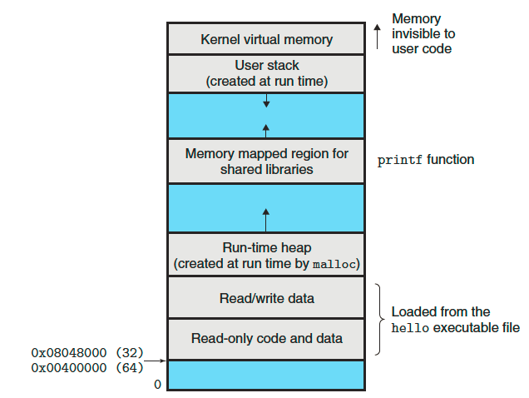
Virtual Memory
Virtual memory is an abstraction that provides each process with the illusion that it has exclusive use of the main memory.
Each process has the same uniform view of memory, which is known as its virtual address space.
Notes:
Processes not only share CPU cores, they also share memory. It’s OS’ job to let the processes to use memory to ensure that each process doesn’t interfere with the portion of memory that used by other processes and by OS itself.

Slide 17
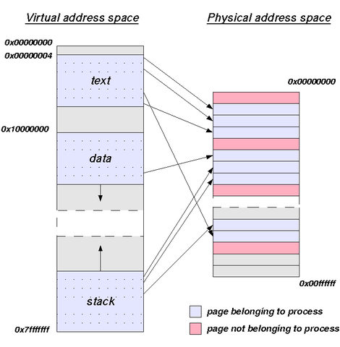
How does Virtual Memory Work?
Virtual memory is a memory management technique that is implemented using both hardware and software.
It maps memory addresses used by a program, called virtual addresses, into physical addresses in computer memory.
The OS manages virtual address spaces and the assignment of real memory to virtual memory.
Memory management unit automatically translates virtual addresses to physical addresses.
Software within the OS may extend these capabilities to provide a virtual address space that can exceed the capacity of real memory and thus reference more memory than is physically present in the computer.
Notes:
When the OS runs a process, it lists its addresses mapping as a table and as the process runs the CPU consults this table to translate process address to address of RAM. Each process has its own complete address space, and OS keeps a separate memory table for each process. Effectively, then the process can be located by the OS in any part of a RAM, and each process can only access its own memory, not the memory of other processes or the memory used by the OS. When the process attempts to use parts of addresses space which is not mapped to the actual RAM in the process’ memory table, the CPU triggers a hardware exception and the OS aborts the process with an error message complaining about the page fault.

Slide 18
Why Virtual Memory?
Freeing applications from having to manage a shared memory space
Increased security due to memory isolation
Being able to conceptually use more memory than might be physically available, using the technique of paging.
What is paging?
Paging is a memory management scheme by which a computer stores and retrieves data from secondary storage for use in main memory.
In this scheme, the OS retrieves data from secondary storage in same-size blocks called pages.

Slide 19
Virtual Address Spaces—Components
Program code and data
Code begins at the same fixed address for all processes, followed by data locations that correspond to global variables. The code and data areas are initialized directly from the contents of an executable object file
Heap
The code and data areas are followed immediately by the run-time heap. Unlike the code and data areas, which are fixed in size once the process begins running, the heap expands and contracts dynamically at run time as a result of calls to standard library routines.
Shared Libraries
Such as C standard library and the math library
Notes:
The process must explicitly request a chunk of heap storage from the OS with system call. The system call will specify what size of contiguous chunk it wants, but the OS decide where to locate these chunks in the address space and the chunk locations are not necessarily adjacent to each other. When the process is done with the heap, it should give the chunk back to the OS with the system call to deallocate. It is OS’ responsibility to keep track of which portion of the address space are free for future allocation.
Due to the allocation and deallocation, the memory space can be more and more fragmented, and shrinking the size that OS can allocate. Because the chunk need to be contiguous. The broader reason for deallocation is your process may run out of address space at some point of time and allocation will fail and process will be terminated pre-maturely. Not appropriately deallocate the memory space is a bug, called memory leak.

Slide 20
Virtual Address Spaces—Components
Stack
At the top of the user’s virtual address space is the user stack that the compiler uses to implement function calls. Like the heap, the user stack expands and contracts dynamically during the execution of the program. In particular, each time we call a function, the stack grows. Each time we return from a function it contracts.
Kernel virtual memory
The top region of the address space is reserved for the kernel. Application programs are not allowed to read or write the contents of this area or to directly call functions defined in the kernel code. Instead, they must invoke the kernel to perform these operations.

Slide 21
Virtual Address Space—Rules
Each process can only access its own memory, while OS can access all the memory of processes.
This is enforced by the CPU running in two different privilege levels
When OS code runs, the CPU is put into a privilege level that allows access to the I/O devices and any address of memory.
When a process runs, the CPU is put into a level that triggers a hardware exception when the code attempts to directly access the I/O devices or addresses that are not allowed for that process.

Slide 22
System Calls –How does Process invoke actions?
System calls are the means that processes initiate request to the OS.
These system call provides functions for things like reading/writing files or sending/receiving data over the network
To invoke system calls, a process must use specific CPU instructions, a system call number. The processor look in the system call table for the address for the system call corresponding to the number and jump execution to that address.
http://cs.uttyler.edu/Faculty/Rainwater/COSC3355/Animations/switch.htm

Slide 23
Files
HD
HD
Flash Drive
CD-Rom
Partition 1
Partition 4
Partition 5
Partition 6
Partition 2
Partition 7
Partition 4
A file is a sequence of bytes. Every I/O device, including disks, keyboards, displays, and even networks, is modeled as a file. All input and output in the system is performed by reading and writing files, using a small set of system calls known as Unix I/O.
This simple and elegant notion of a file is nonetheless very powerful because it provides applications with a uniform view of all the varied I/O devices that might be contained in the system. For example, application programmers who manipulate the contents of a disk file are blissfully unaware of moving head and spinning platters in the disk.
Notes:
Device drivers handle the business of how exactly to talk to an I/O device, that include storage device like hard drive. However, OS provides an extra larger of abstraction for storage devices called the file system, which presents the storage space as a hierarchy of directories and files store in these directories. When your program uses a hard drive, you don’t want to think about moving had and spinning platters. You just want to read/write data on a contiguous unit called file. And you want to have these files organized in the directories. The file system provides the abstraction, allow the program to read/write data from any kind of storage in the same way (hard drive, flash drive, CD-Rom,…) The storage area of each drive is divided into one or more contiguous chunks called partitions.

Slide 24
Threads
Although we normally think of a process as having a single control flow, in modern system a process can actually consist of multiple execution units, called threads, each running in the context of the process and sharing the same code and global data.
Threads are increasingly important because of
the requirement for concurrency in network servers,
It is easier to share data between multiple threads than between multiple processes
Threads are typically more efficient than processes
Process
Thread 1
Thread 2
time

